Slide 1
Partial Observability and Belief States
AINT351 Machine Learning

Slide 2
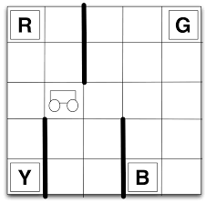
Partial Observability
Commonly we cannot uniquely identify the state of the world
Limited sensors
Sensor noise
Historical events
Need memory to tell states apart
Replace states with observations

Slide 3
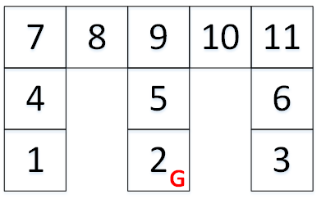
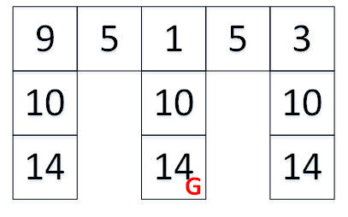
Limited Sensors in a Grid World
Encode what walls are present
Add up the present walls
North 1, East 2, South 4, West 8
States Observations

Slide 4
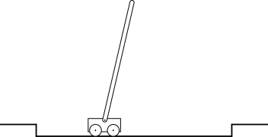
Pole Balancing
MPD
State includes cart position, pole angle, cart speed and rotational speed of pole
POMDP
State includes only position and angle
Algorithm must implicitly estimate speeds based on memory of observed position and angle

Slide 5
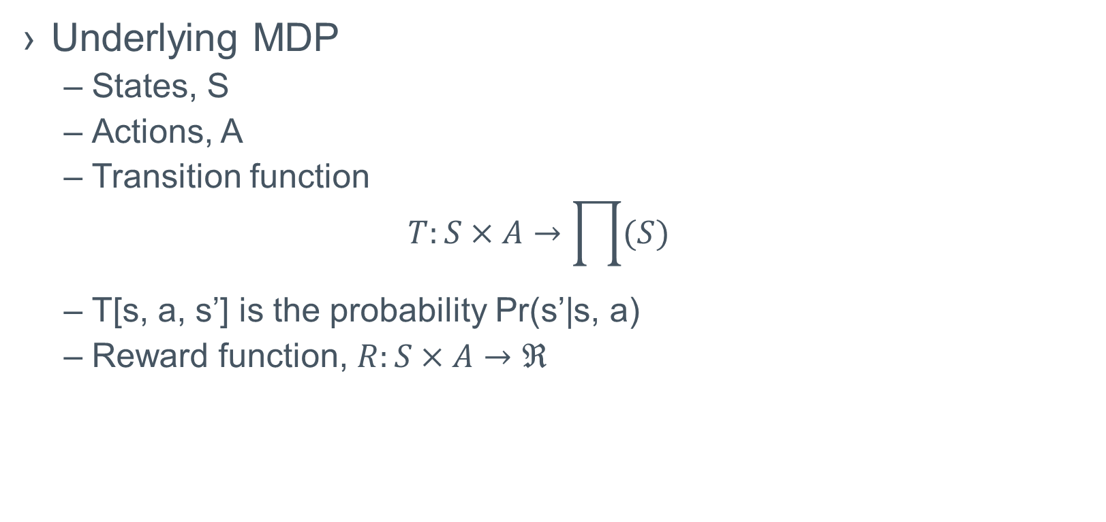
POMDP Formalisation
Underlying MDP
States, S
Actions, A
Transition function
$$T:S×A→\prod{(S)}$$
T[s, a, s’] is the probability Pr(s’|s, a)
Reward function, $R:S×A→ℜ$

Slide 6
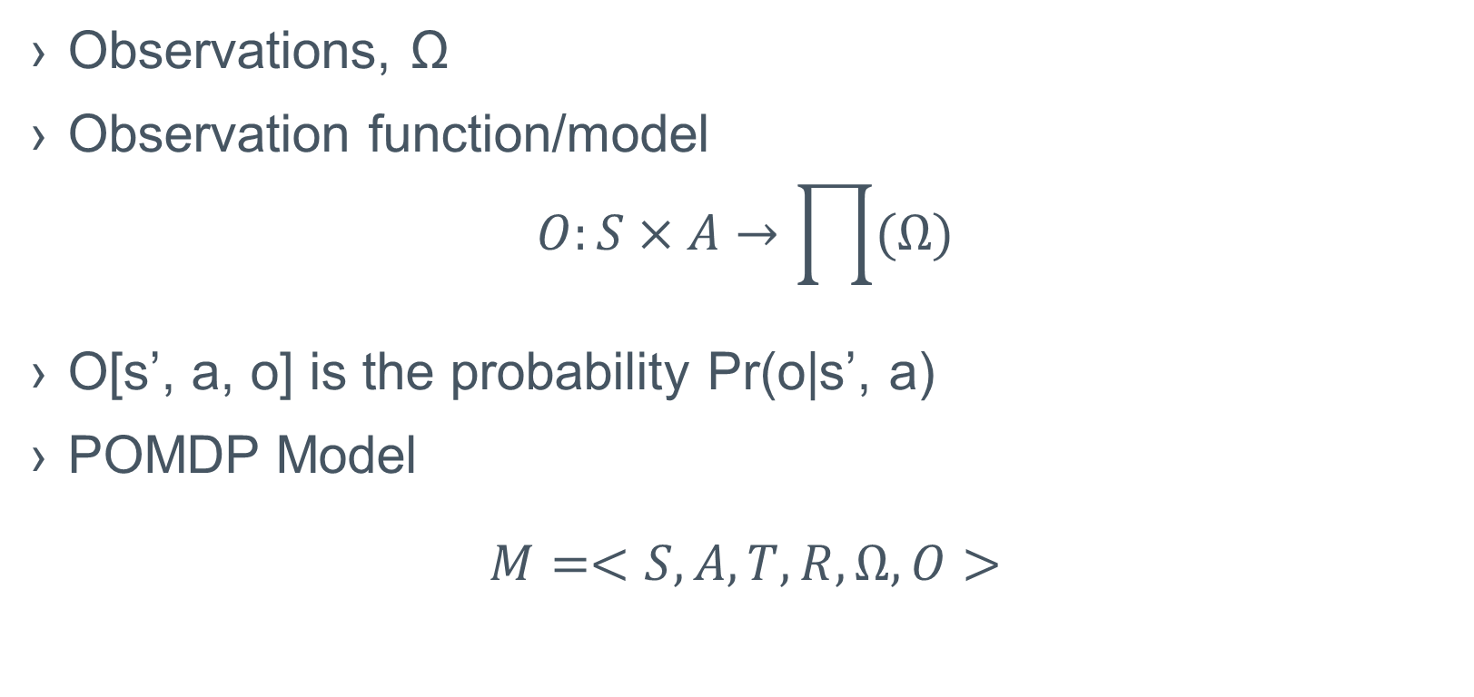
Limited Observability
Observations, Ω
Observation function/model
$$O:S×A→\prod{(Ω)}$$
O[s’, a, o] is the probability Pr(o|s’, a)
POMDP Model
$$M=<S, A, T, R, Ω,O>$$

Slide 7
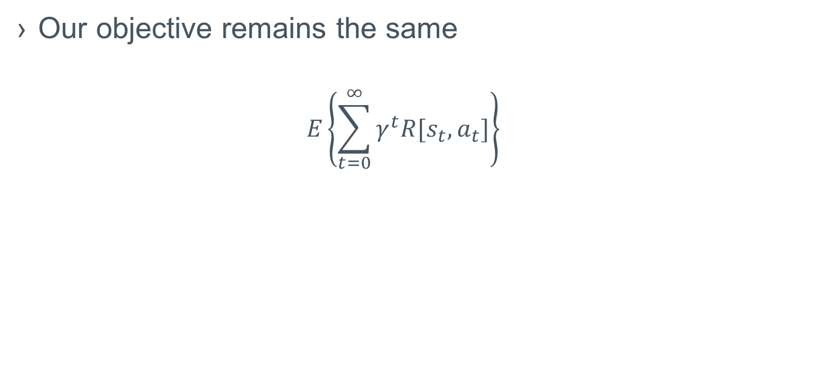
Objective and Belief State
Our objective remains the same
$$E\left\{\sum_{t=0}^{∞}{γ^{t}R[s_{t},a_{t}]}\right\}$$

Slide 8
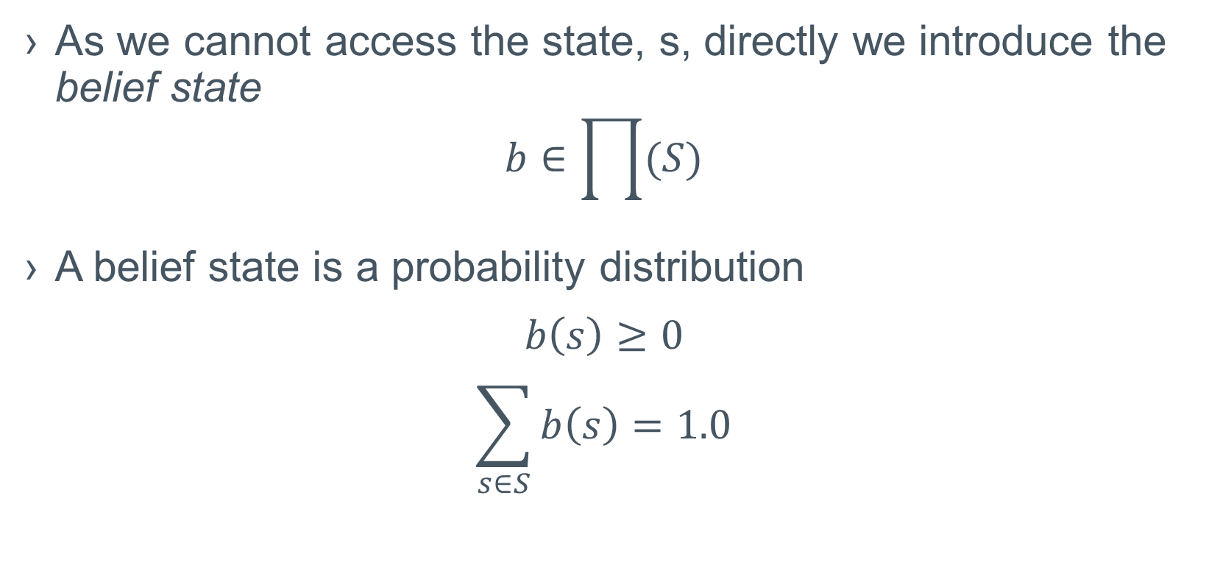
Belief State
As we cannot access the state, s, directly we introduce the belief state
$$b∈\prod{(S)}$$
A belief state is a probability distribution
$$b\left(s\right)≥0$$
$$\sum_{s∈S}{b\left(s\right)=1.0}$$

Slide 9
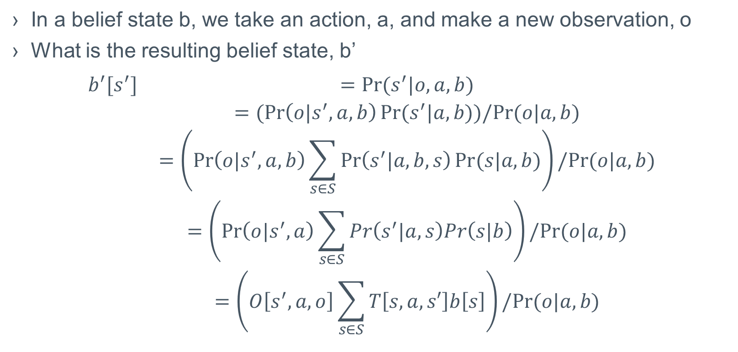
Belief Update
In a belief state b, we take an action, a, and make a new observation, o
What is the resulting belief state, b’
$$\begin{matrix}b^{′}[s^{′}] & =Pr⁡(s^{′}|o,a,b) \\ & =(\operatorname{Pr}\left(o|s^{′},a,b\right)Pr⁡(s^{′}|a,b))/Pr⁡(o|a,b) \\ & =\left(\operatorname{Pr}\left(o|s^{′},a,b\right)\sum_{s∈S}{\operatorname{Pr}\left(s^{′}|a,b,s\right)Pr⁡(s|a,b)}\right)/Pr⁡(o|a,b) \\ & =\left(\operatorname{Pr}\left(o|s^{′},a\right)\sum_{s∈S}{Pr\left(s^{′}|a,s\right)Pr\left(s|b\right)}\right)/Pr⁡(o|a,b) \\ & =\left(O\left[s^{′},a,o\right]\sum_{s∈S}{T\left[s,a,s′\right]b\left[s\right]}\right)/Pr⁡(o|a,b)\end{matrix}$$

Slide 10
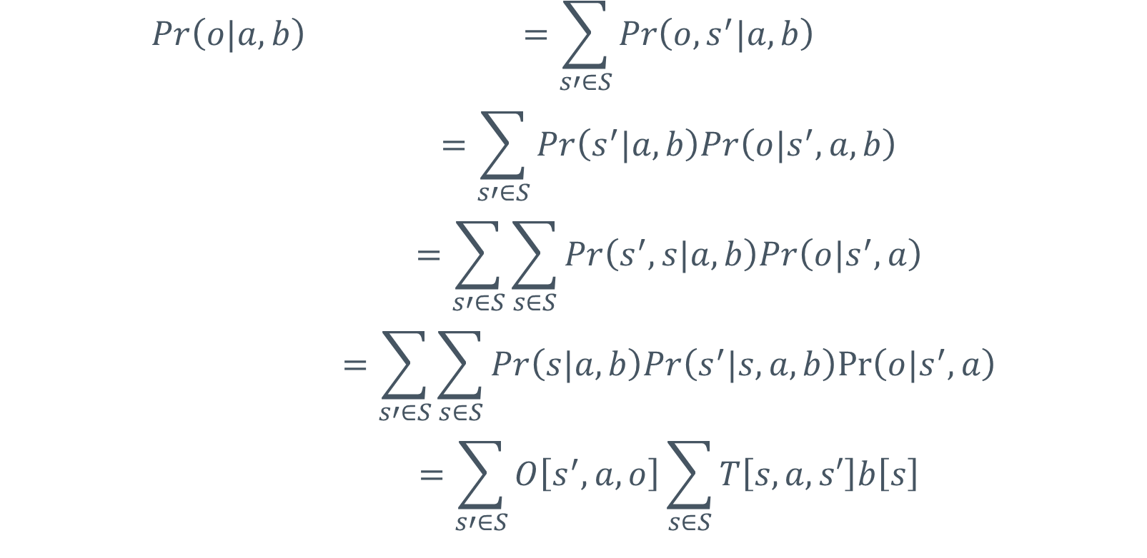
Computing the normalizing denominator
$$\begin{matrix}Pr\left(o|a,b\right) & =\sum_{s′∈S}{Pr\left(o,s^{′}|a,b\right)} \\ & =\sum_{s′∈S}{Pr\left(s^{′}|a,b\right)Pr\left(o|s^{′},a,b\right)} \\ & =\sum_{s′∈S}{\sum_{s∈S}{Pr\left(s^{′},s|a,b\right)Pr\left(o|s^{′},a\right)}} \\ & =\sum_{s′∈S}{\sum_{s∈S}{Pr\left(s|a,b\right)Pr\left(s^{′}|s,a,b\right)Pr⁡\left(o|s^{′},a\right)}} \\ & =\sum_{s′∈S}{O\left[s^{′},a,o\right]\sum_{s∈S}{T\left[s,a,s′\right]b\left[s\right]}}\end{matrix}$$

Slide 11
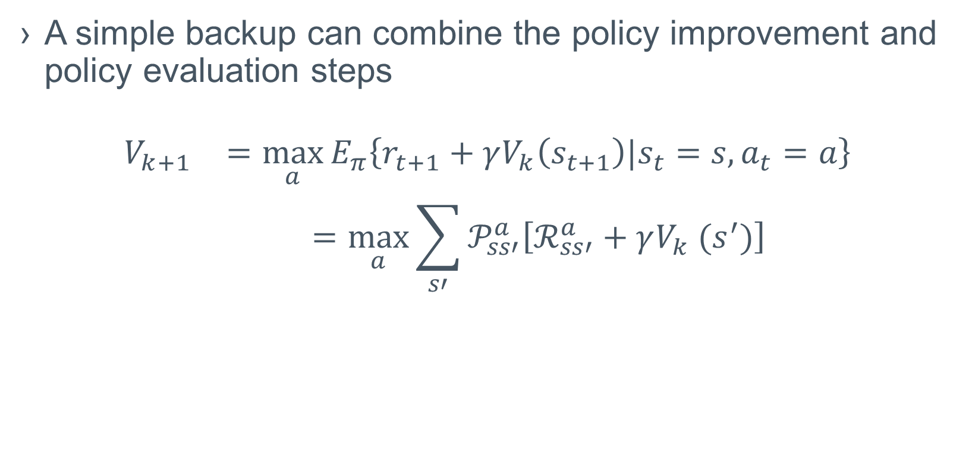
MDP Value Iteration
A simple backup can combine the policy improvement and policy evaluation steps
$$\begin{matrix}V_{k+1} & =\max_{a}{E_{π}\left\{r_{t+1}+γV_{k}\left(s_{t+1}\right)|s_{t}=s,a_{t}=a\right\}} \\ & =\max_{a}{\sum_{s′}{𝒫_{ss′}^{a}\left[ℛ_{ss′}^{a}+γV_{k} (s^{′})\right]}}\end{matrix}$$

Slide 12
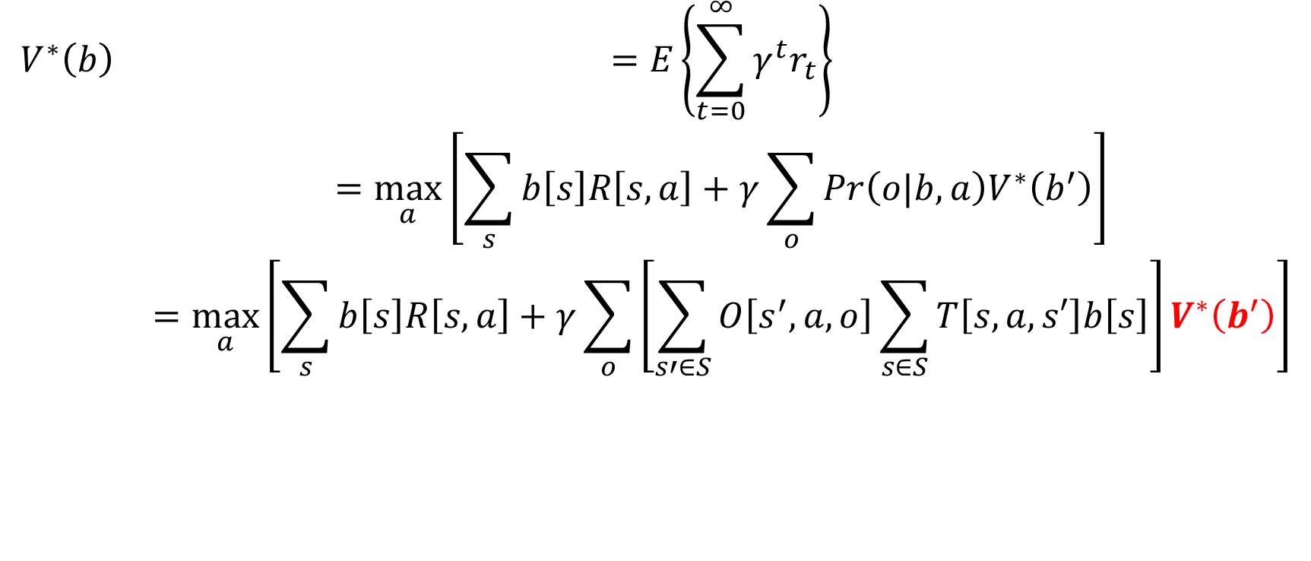
POMDP Value Functions
$$\begin{matrix}V^{∗}\left(b\right) & =E\left\{\sum_{t=0}^{∞}{γ^{t}r_{t}}\right\} \\ & =\max_{a}\left[\sum_{s}{b\left[s\right]R\left[s,a\right]}+γ\sum_{o}{Pr\left(o|b,a\right)V^{∗}\left(b^{′}\right)}\right] \\ & =\max_{a}\left[\sum_{s}{b\left[s\right]R\left[s,a\right]}+γ\sum_{o}{\left[\sum_{s′∈S}{O\left[s^{′},a,o\right]\sum_{s∈S}{T\left[s,a,s′\right]b\left[s\right]}}\right]V^{∗}\left(b^{′}\right)}\right]\end{matrix}$$

Slide 13
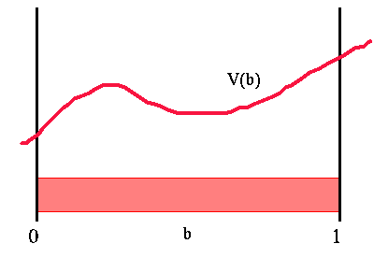
POMDP Value Functions
Continuous belief states
E.g., 1d belief space for two-state POMDP
We cannot make a table to keep continuous belief-state values

Slide 14
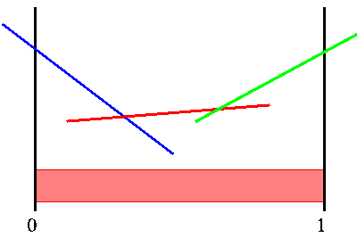
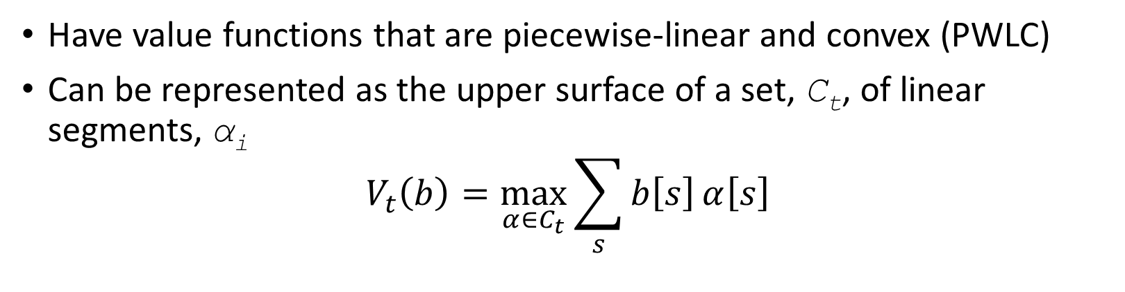
Finite-Horizon POMDPs
Have value functions that are piecewise-linear and convex (PWLC)
Can be represented as the upper surface of a set, C_{t}, of linear segments, α_{i}
$$V_{t}\left(b\right)=\max_{α∈C_{t}}{\sum_{s}{b\left[s\right]}α\left[s\right]}$$

Slide 15
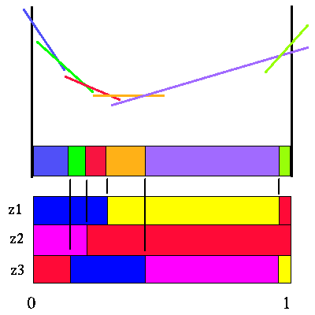
POMDP Value Iteration
Finding all vectors, α
Construct all policy trees using a DP approach
Each action and observation adds new α-vectors to C_{t}

Slide 16
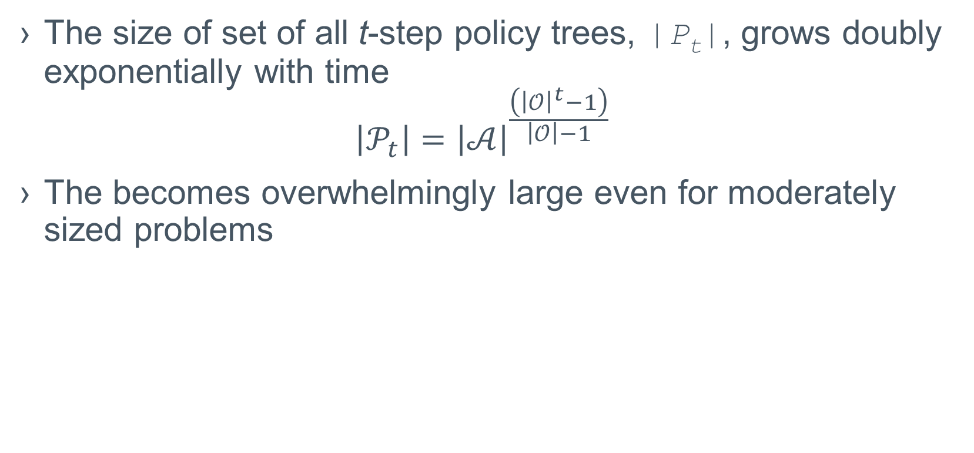
Naïve Algorithm Complexity
The size of set of all t-step policy trees, |P_{t}|, grows doubly exponentially with time
$$\left|𝒫_{t}\right|={\left|𝒜\right|}^{\frac{\left({\left|𝒪\right|}^{t}−1\right)}{\left|𝒪\right|−1}}$$
The becomes overwhelmingly large even for moderately sized problems

Slide 17
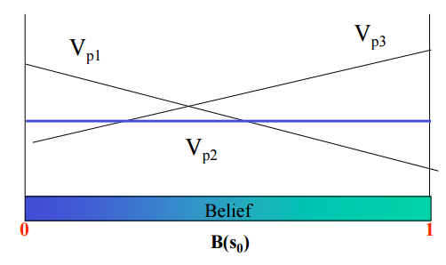
Reducing the number of α-vectors
Only add trees that contribute to the maximum (Witness)
For a sub-tree, can we reach an optimal belief state, b
If not, don’t add more α-vectors
Remove vectors that are dominated (Incremental Pruning)
Never contribute to the maximum

Slide 18
Point-Based Value Iteration
Maintaining a full set of α-vectors is too complex
Point-based algorithms approximates Vt(b)
Keeps only a sample set of α-vectors (points)

Slide 19
POMDP and Memory
Constructivist approaches
Do not require access to state space or transition functions
Long Term Memory (LTM)
Previously seen sequences of observations, actions and rewards
Previous episodes
Short Term Memory (STM)
Recently seen sequence of observations, actions and rewards
State identification
Implicit
Previously seen sequences that best match recently seen sequences
Best matches between LTM and STM

Slide 20
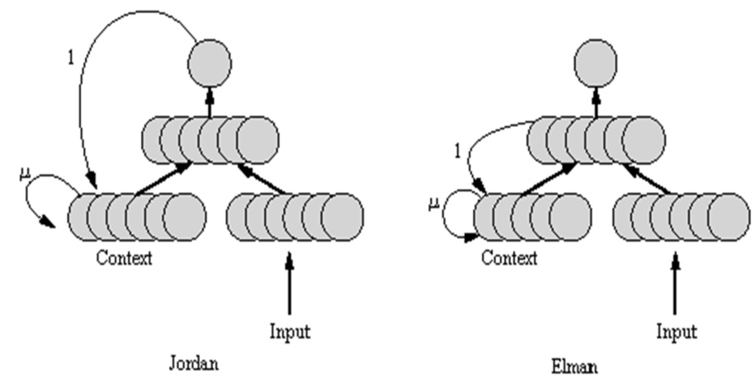
Recursive Neural Networks for PMDPs
Use RNNs to encode Q-functions
Recurrent connection weights encode observed sequences, LTM
Forward feed values represent recently observed sequences, STM

Slide 21
Instance-Based Methods
Do not construct a theory
Does classification/regression from the raw data each time
Complexity is limited by the size of the training set

